Slide 1

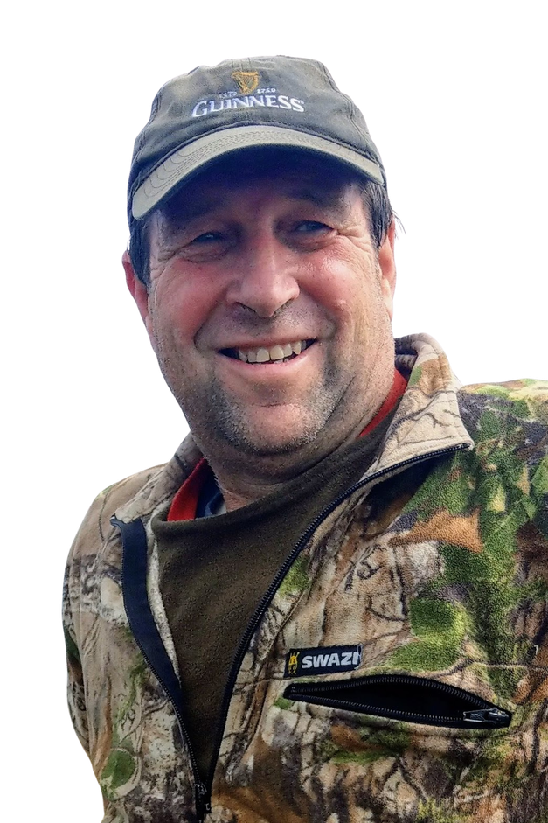
GERRY KESSELS
RESTORING CONNECTION
KŌKAKO + PEKAPEKA-TOU-ROA
Kōkako and pekapeka-tou-roa are two of our most treasured threatened species. While they occupy different ecological niches, together they reveal an important truth: everything is connected.

Slide 2
Kōkako, Pekapeka-tou-roa, and Restoring Connection
Gerry (G.H.A.) Kessels

Slide 3
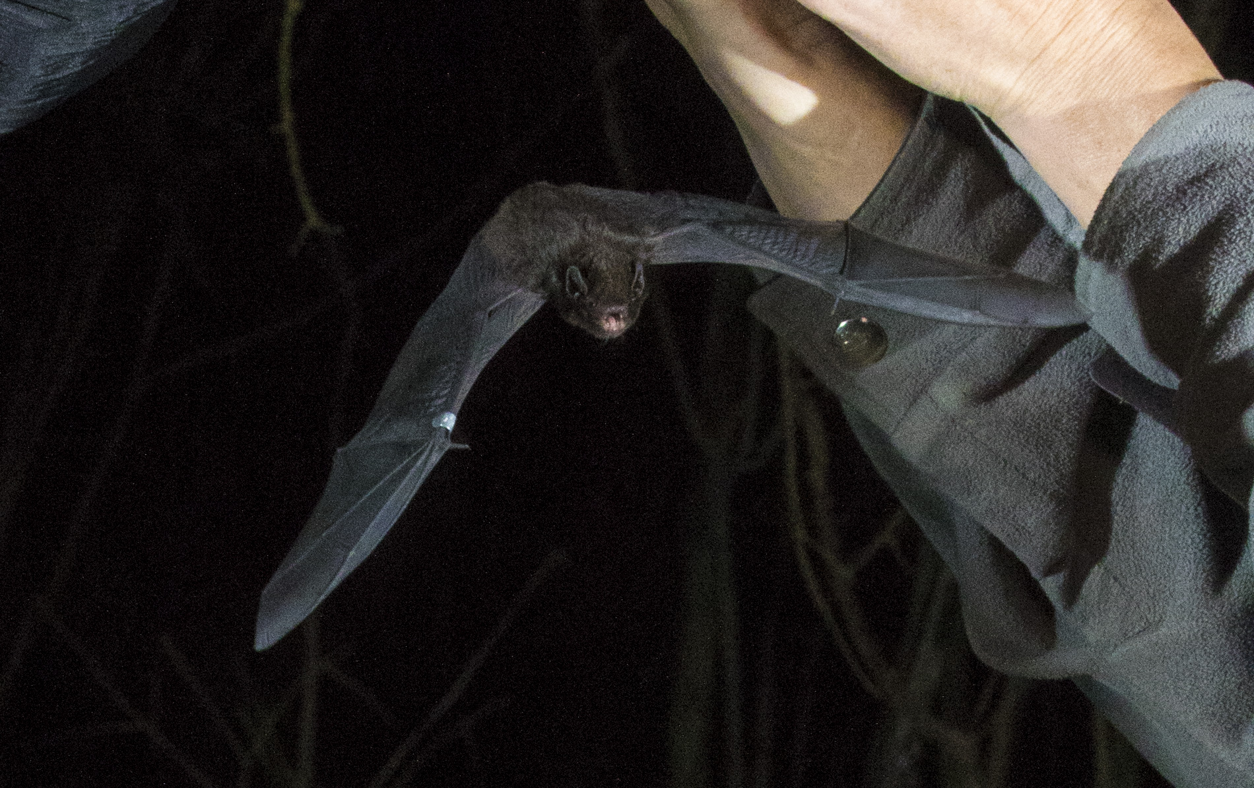
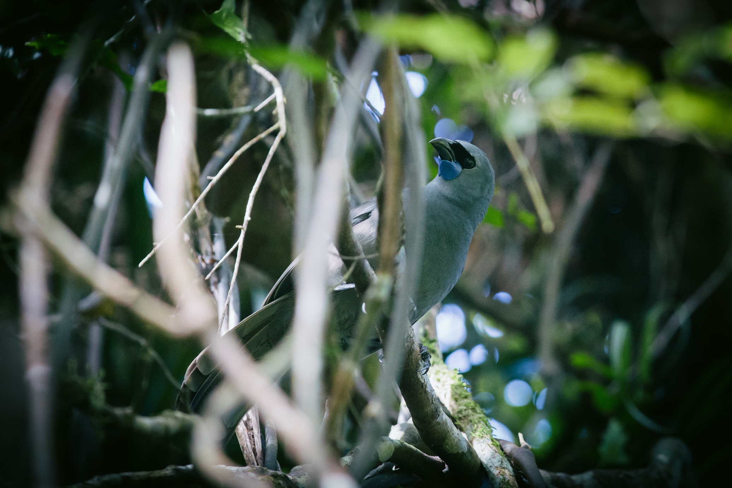
Kōkako
Pekapeka-tou-roa
Different treasures
But connecting the whenua and the people by the same paths
DOC courtesy of Andrew Styche
Amanda Rogers & Dave Bryden
Notes:
A kōkako sings from a place shaped over centuries. A pekapeka may cross a farm, river, motorway or subdivision in a single night. One asks whether we can protect what remains. The other asks whether we can reconnect what we have broken.
After 35 years working as an ecologist - much of it in the merciless realm of the RMA - I have come to believe that saving these species is not only about keeping them from extinction. It is about relearning how to live in a place. Kōkako Pekapeka-tou-roa
Depth Connection
Forest interior Landscape-scale movement
Seasonal forest pantry Aerial insect foraging
Limited dispersal Large nightly range
Complex native habitat Flexible matrix use
Exposed while nesting Exacting roost requirements
Your line:
The contrast is not specialist versus generalist. It is forest dependence versus landscape mobility - and both are more complicated than those labels suggest.

Slide 4
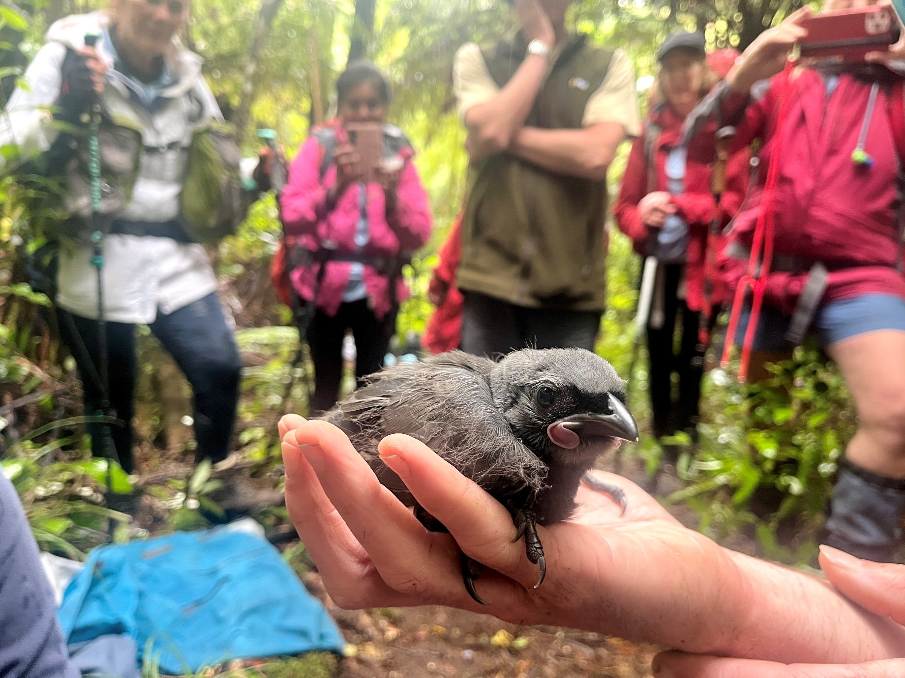
  Kōkako teaches us to protect depth: mature forest, ecological complexity and continuity through time.
  Pekapeka-tou-roa teaches us to restore connection: safe pathways through farms, forests, waterways and cities.
  Both teach us that conservation is ultimately a relationship and connections between people, place and the other lives that now depend on us saving them from extinction .
Amanda Rogers & Dave Bryden

Slide 5
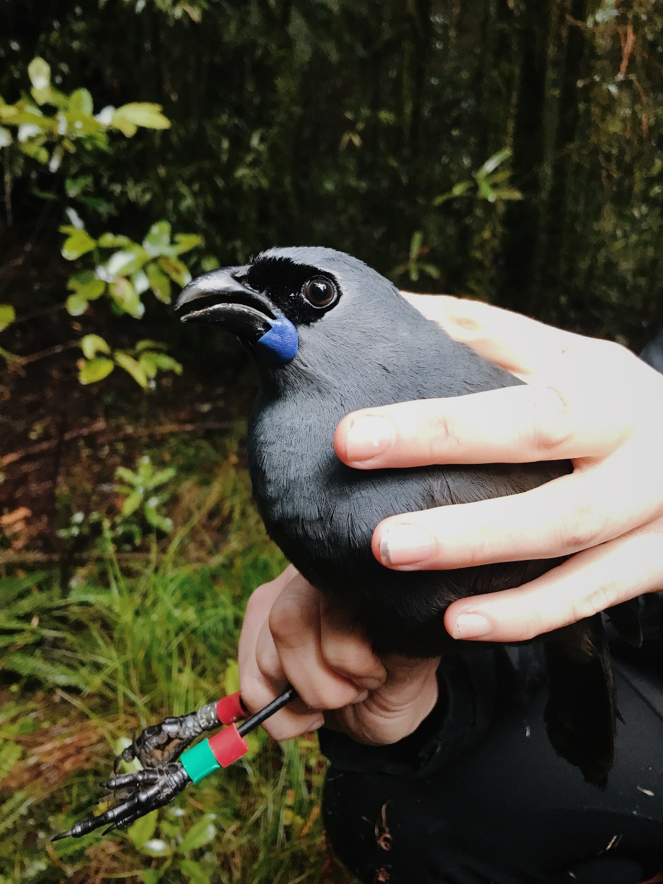
  Kōkako are obligate forest birds whose survival depends on structurally complex native forest and a varied seasonal food supply. They eat many foods, but at different times rely heavily on a relatively small number of fruits, leaves, flowers, nectar and invertebrate resources.
Amanda Rogers & Dave Bryden
Notes:
A Puketi study recorded 68 foods, but only eight contributed more than 5% of the observed diet in any season. That is a better description of selective seasonal dependence within a diverse forest pantry than simple dietary specialisation. New Zealand Ecological Society
Kōkako are currently classified as Threatened - Nationally Increasing, but that success remains dependent on conservation management. All known current populations are pest-managed, and unfenced mainland populations are often limited by the area under pest control rather than the total forest available.

Slide 6
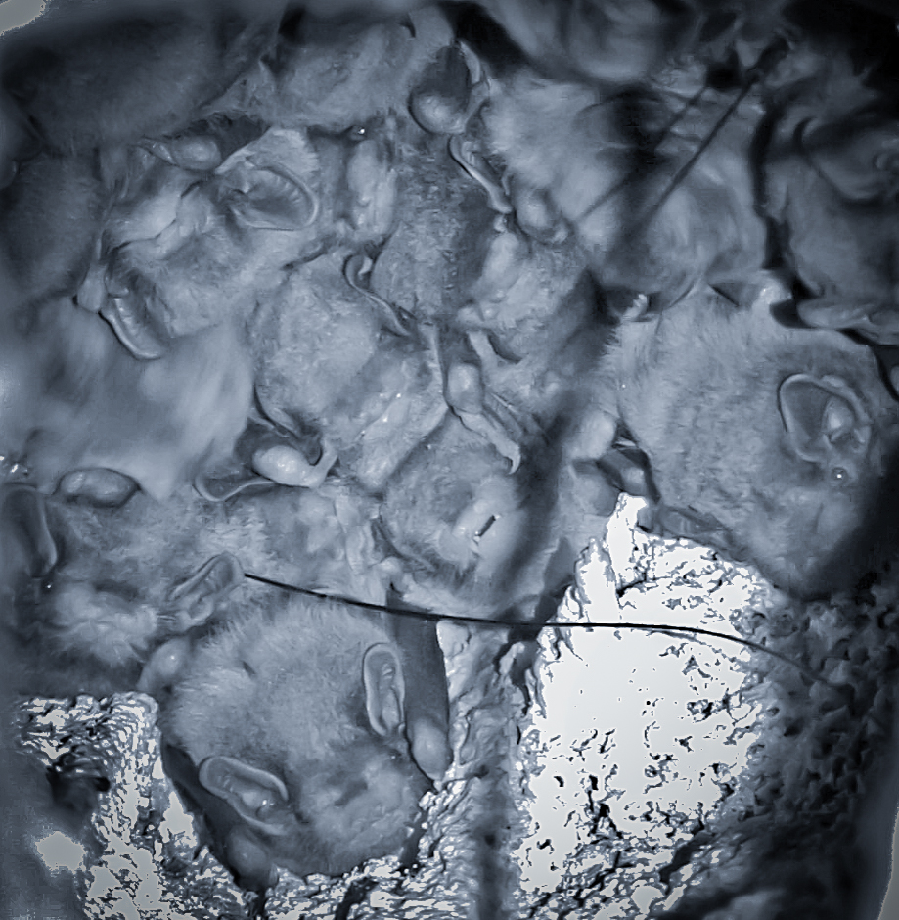
  Pekapeka-tou-roa are flexible in where they travel and feed, but surprisingly demanding about where they can safely roost and reproduce.
  A bat detector can record a bat flying through a development site.
  That does not mean the landscape is sustaining a bat population. Activity is not the same as habitat security.
Ian Davidson-Watts
Notes:
They use native forest, plantation forest, riparian corridors, farmland and urban or peri-urban landscapes. But they depend on networks of suitable roost trees, frequently change roosts, produce only one young annually, retain fidelity to traditional roosting areas and remain vulnerable to predators and tree removal. Pekapeka-tou-roa remain Threatened - Nationally Critical. Evidence indicates that unmanaged populations can decline rapidly, while intensive predator control has reversed declines at some sites. Colonies may range so widely that a predator-control footprint protects only part of the landscape they use.

Slide 7
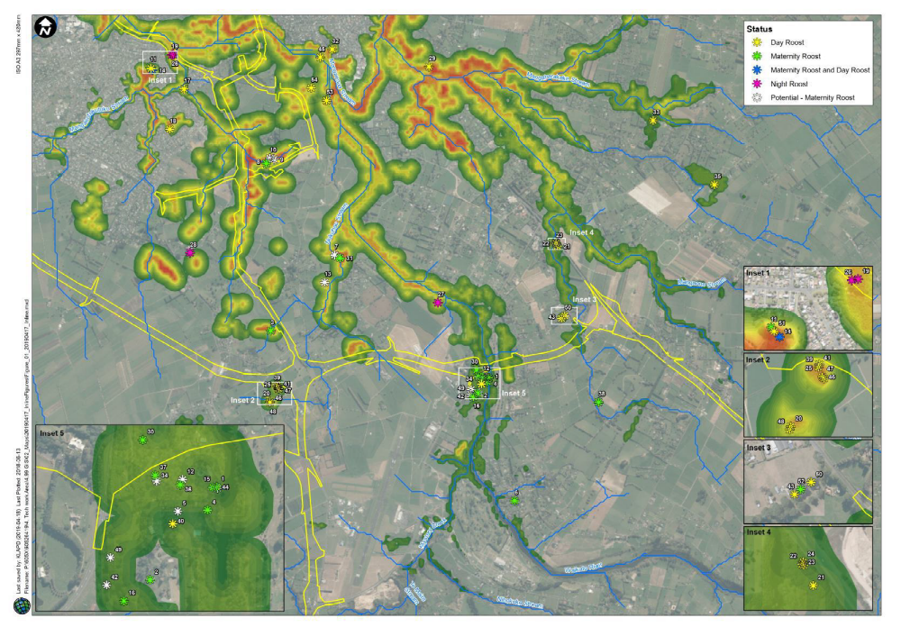
A line on a district-plan map can protect hectares. It cannot, by itself, protect ecological function
Notes:
Predictive habitat model for long-tailed bats in southern Hamilton (Crewther & Parsons 2017). Red/orange indicates habitats of high potential while greens indicate habitats of low potential based on historical bat records. Distribution on known bat roosts also shown (Davidson-Watts, 2019). Yellow line shows Southern Links designation . They use native forest, plantation forest, riparian corridors, farmland and urban or peri-urban landscapes. But they depend on networks of suitable roost trees, frequently change roosts, produce only one young annually, retain fidelity to traditional roosting areas and remain vulnerable to predators and tree removal. Pekapeka-tou-roa remain Threatened - Nationally Critical. Evidence indicates that unmanaged populations can decline rapidly, while intensive predator control has reversed declines at some sites. Colonies may range so widely that a predator-control footprint protects only part of the landscape they use.

Slide 8
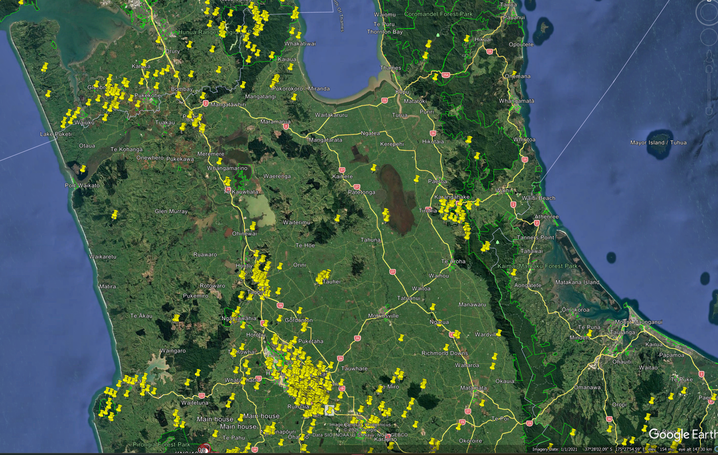
Pekapeka do not recognise property boundaries. Unfortunately, most of our planning instruments do.
Notes:
Pekapeka-tou-roa can commute and forage across highly modified landscapes.
Forest edges and relatively uncluttered riparian corridors can provide movement and feeding opportunities.
Plantation forests can be used, but clear-felling may remove roosts and disrupt colonies; plantation use should not be mistaken for immunity to harvesting.
Urban populations occur, including in Kirikiriroa, but persistence in a city is not evidence that urban development is harmless.
Suitable cavities, old trees, dark movement routes, connected vegetation and predator control remain critical.
Artificial roosts may contribute in particular settings, but they are not a simple substitute for mature roost-tree networks

Slide 9
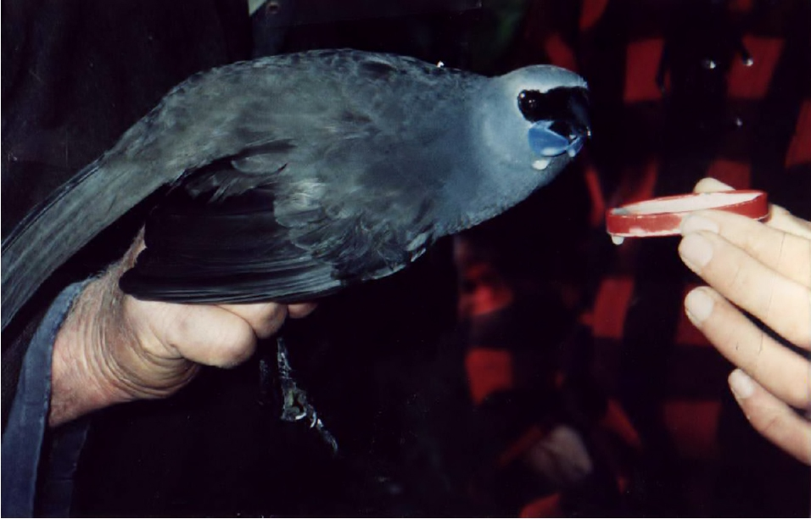
Different ecologies.
The same warning and same hope:
Alive does not mean secure.
Present does not mean protected.
Increasing does not mean independent.
Notes:
Talk about saving the last kōkako from Pirongia . Kōkako recovery demonstrates that science-led, sustained management can reverse decline.
Pekapeka show why a species can remain present across a broad landscape while continuing to decline.
Both need persistent vigilance against predators.
Both need habitat protected not as isolated polygons but as functioning systems.
Both expose the danger of treating a consent condition or mitigation package as the endpoint.
The evidence from kōkako is unusually strong: reducing rats and possums to very low levels produced marked increases in chick output and adult density.

Slide 10
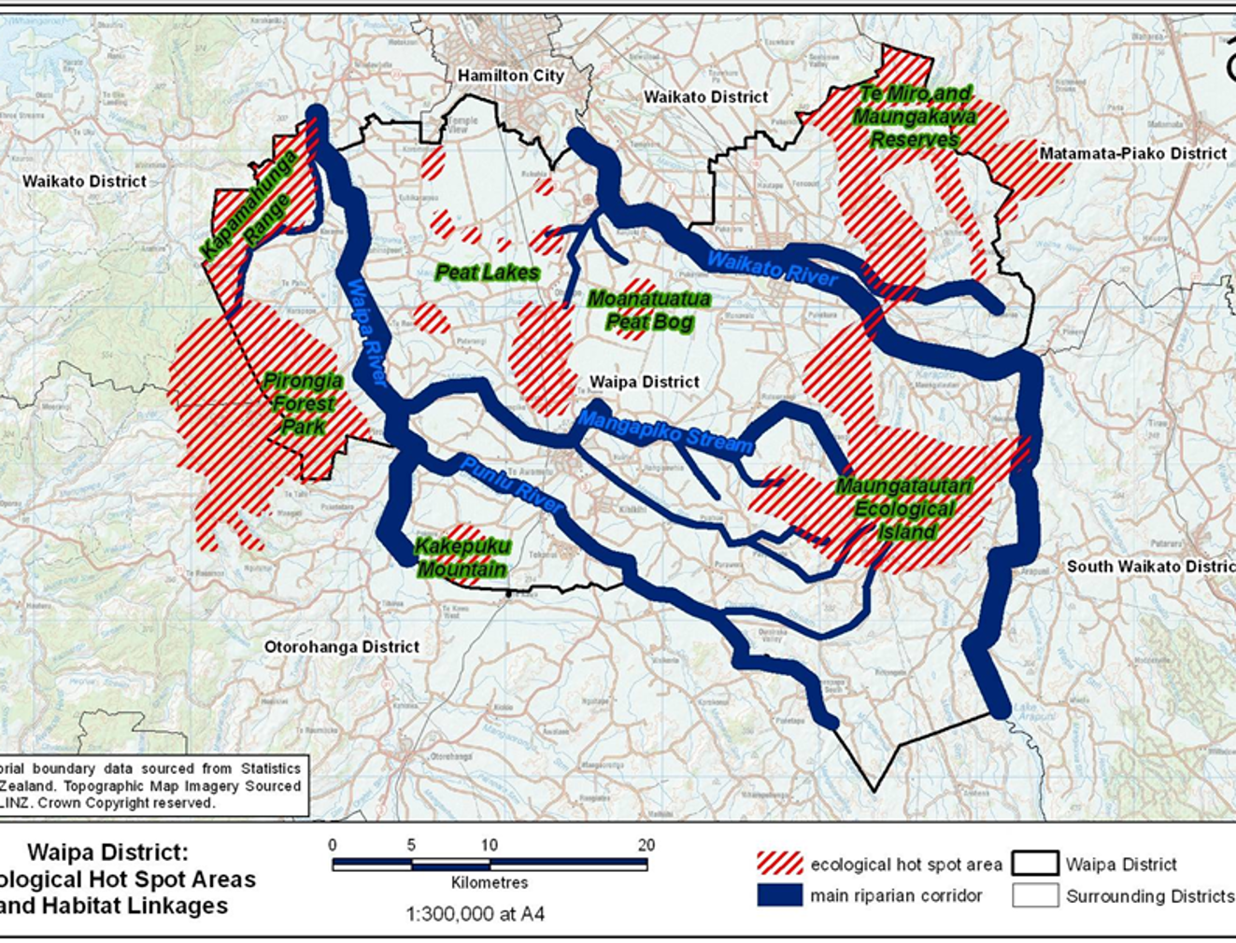
Consultation asks people to comment on somebody else's answer.
Collaboration allows them to help frame the question.
Partnership shares the authority to decide
Notes:
a "significant" tree or fragment that looked insignificant to a decision-maker; a bat record treated as an obstacle rather than information; a covenant secured but not subsequently maintained; ecological effects reduced to a compensation calculation; a landowner initially resistant but won over through a site visit;
mana whenua consulted after the design had effectively been completed. Build it around three moments: What the ecological evidence said. What the process tried to turn it into. What changed when people met the living place together.

Slide 11
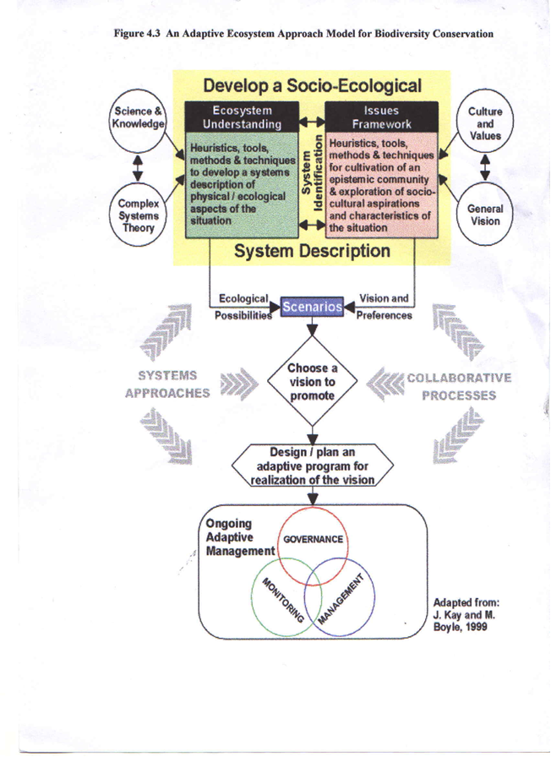
Twenty-five years ago, I concluded that conservation had to link people with ecology, people with people, and cross legal, cultural and economic boundaries.
Thirty-five years in practice have not persuaded me otherwise.
Notes:
Integration matters. Multidisciplinary and interagency partnerships improve decisions and monitoring.
Tangata whenua are Treaty partners, not another stakeholder in a consultation list.
Communities are willing to participate when participation is meaningful.
The main barriers are often institutional, political, personal and financial - not lack of public concern.
Leadership, flexibility and a shared vision determine whether collaboration works.
Local and Indigenous knowledge build better decisions, trust and legitimacy.

Slide 12
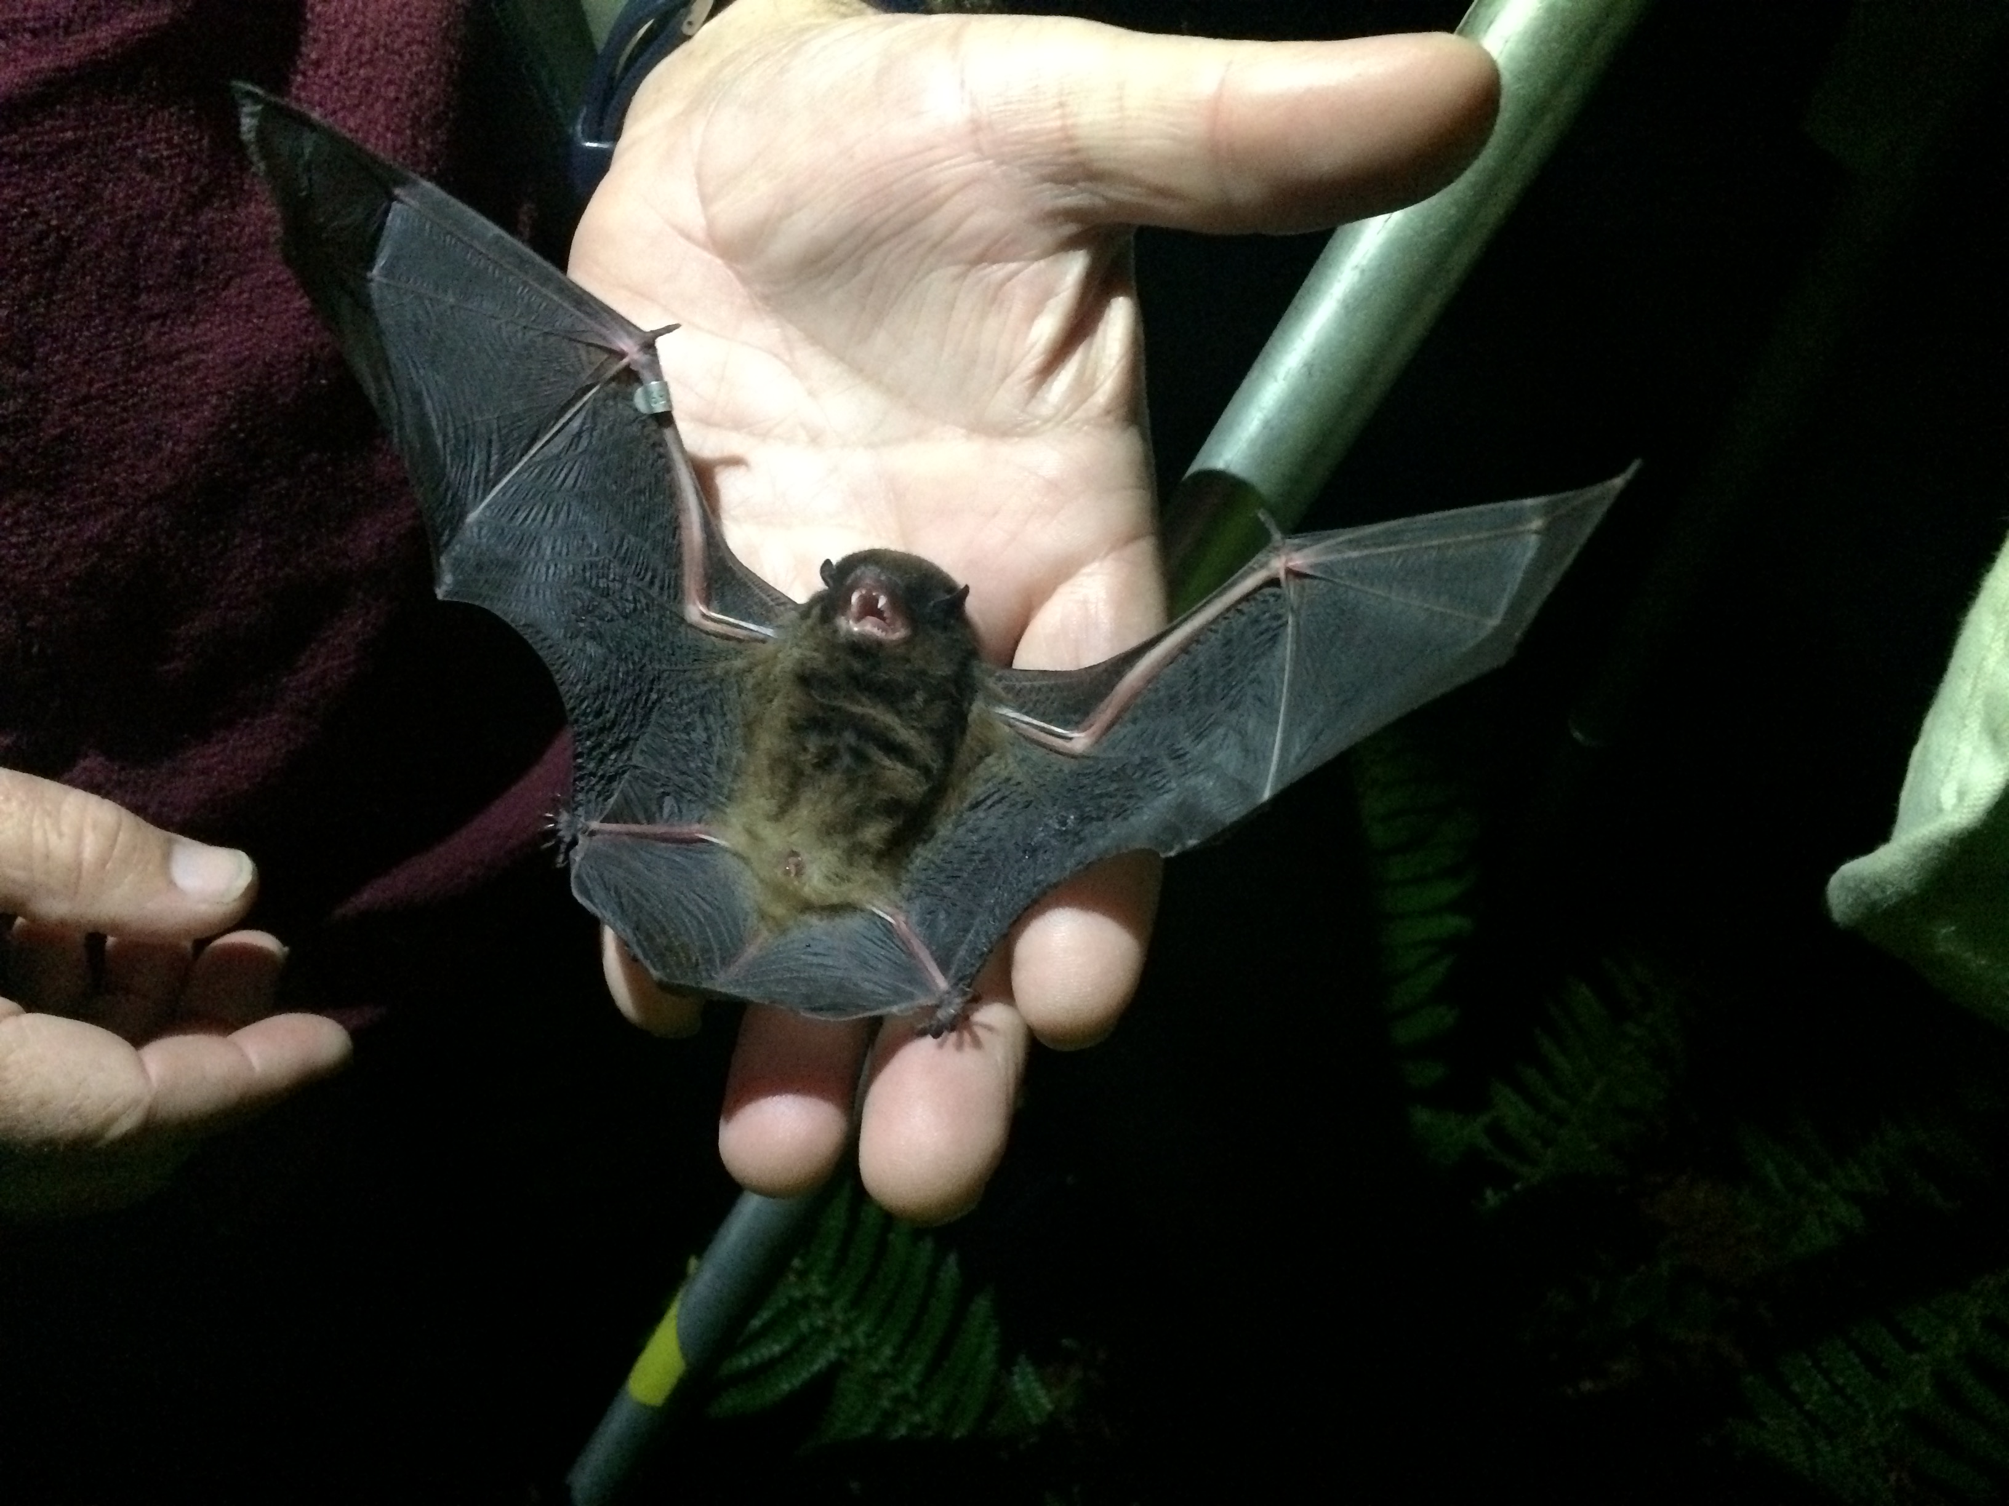
The argument was never regulation versus voluntary action.
The solution is what combination will endure and reconnect in this place, with these people, for this shared ecological vision.
Hannah Mueller
Notes:
Rules establish the ecological bottom line. They prevent irreversible loss and make public responsibilities visible.
Incentives make stewardship possible. Funding, fencing, pest-control materials, covenants and technical help reduce the private burden of delivering public benefit.
Relationships turn compliance into commitment. Your report found direct, one-to-one contact highly effective, although time- and resource-intensive.
Monitoring closes the loop. Protection on paper does not tell us whether ecological condition is improving.
Long-term support matters more than project launches. A community group cannot carry permanent ecological obligations on temporary grants and goodwill alone.

Slide 13
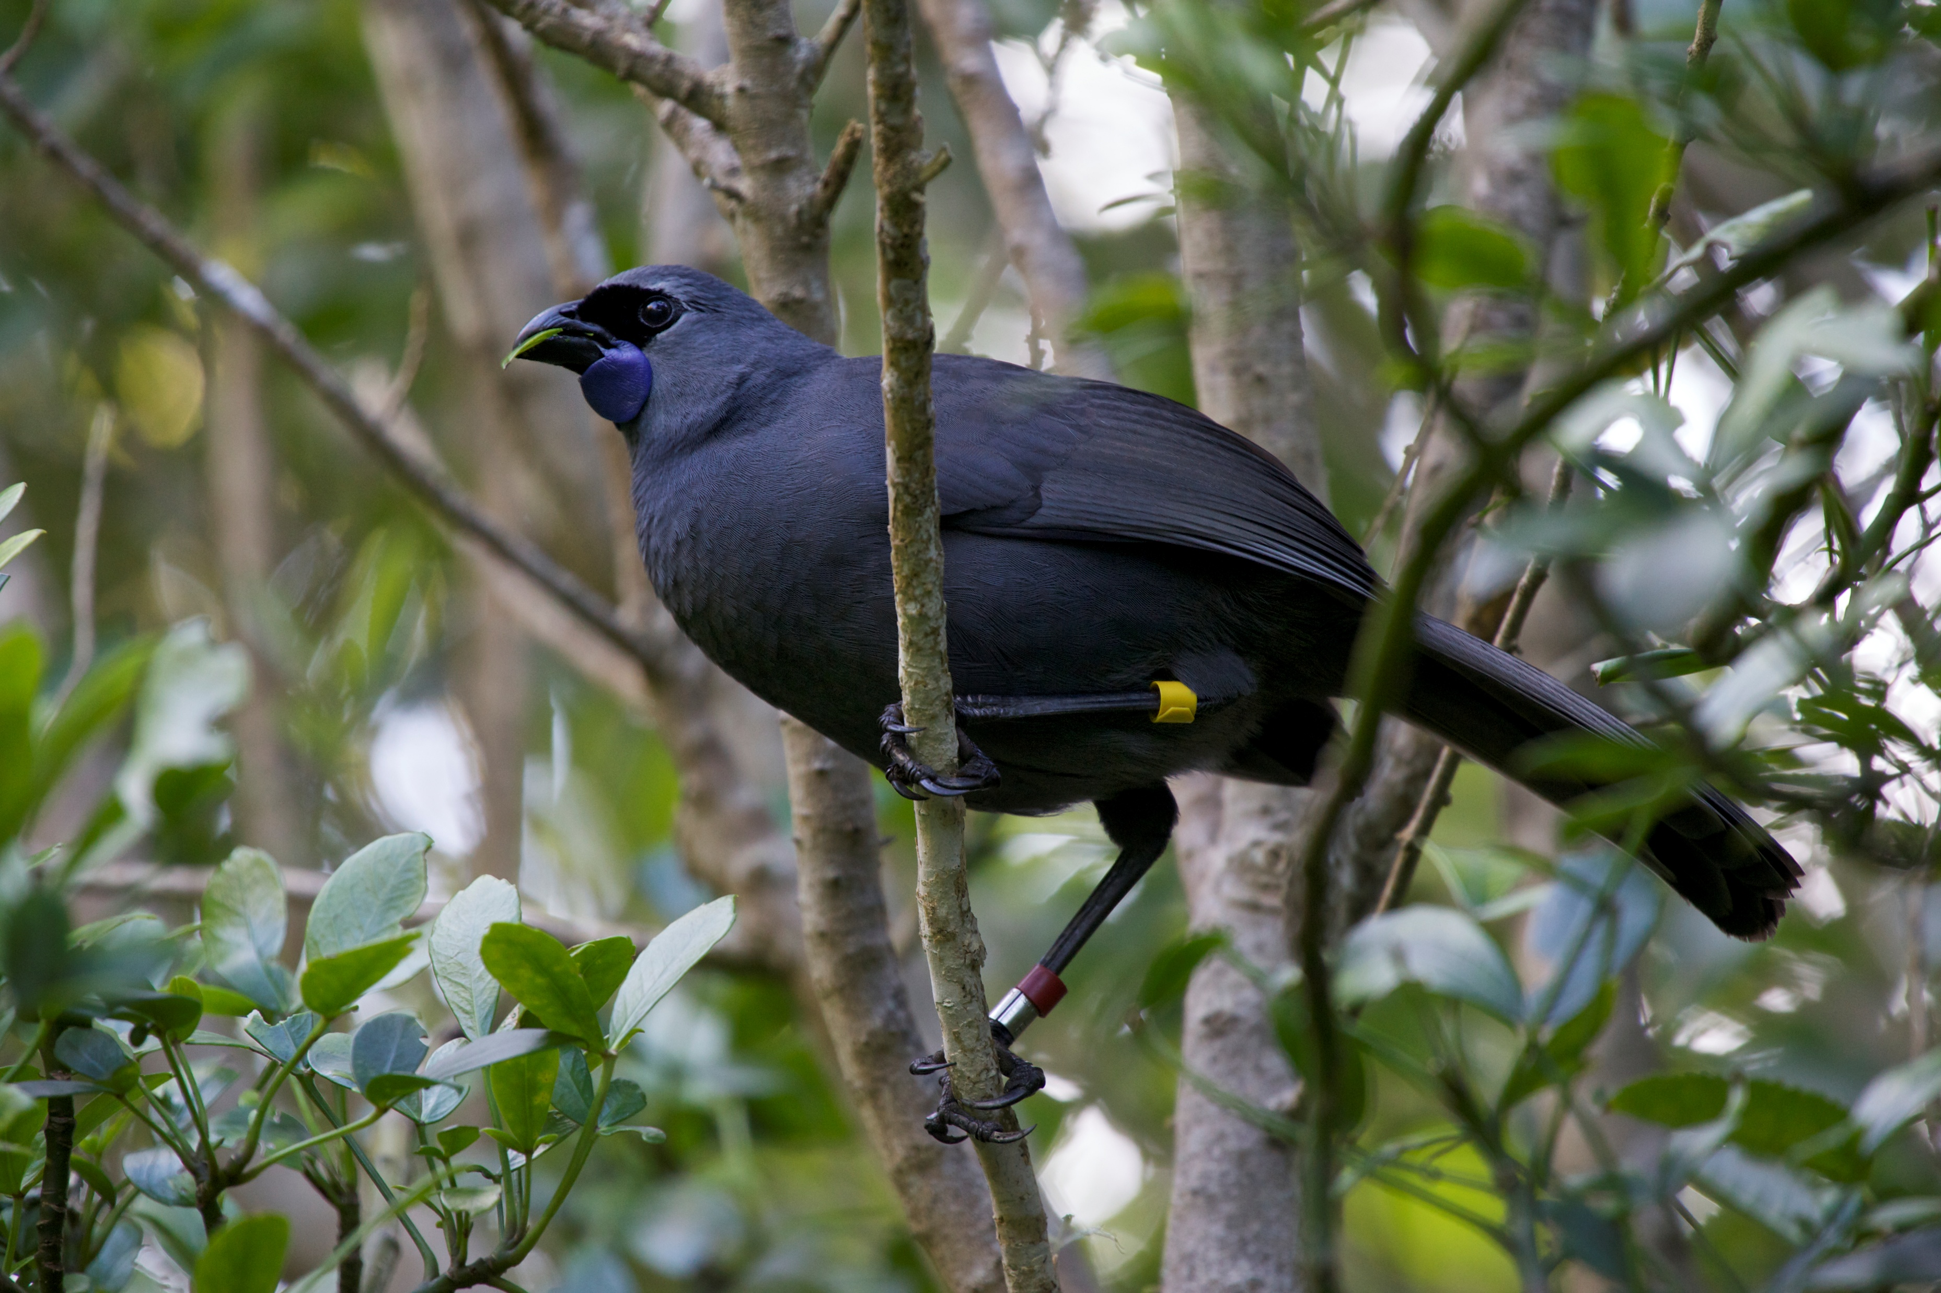
Kōkako asks us to protect the deep forest - the old trees, the seasonal abundance, the relationships built over millennia.
Notes:
Talk about saving the last kōkako from Pirongia . Kōkako recovery demonstrates that science-led, sustained management can reverse decline.
Pekapeka show why a species can remain present across a broad landscape while continuing to decline.
Both need persistent vigilance against predators.
Both need habitat protected not as isolated polygons but as functioning systems.
Both expose the danger of treating a consent condition or mitigation package as the endpoint.
The evidence from kōkako is unusually strong: reducing rats and possums to very low levels produced marked increases in chick output and adult density.

Slide 14
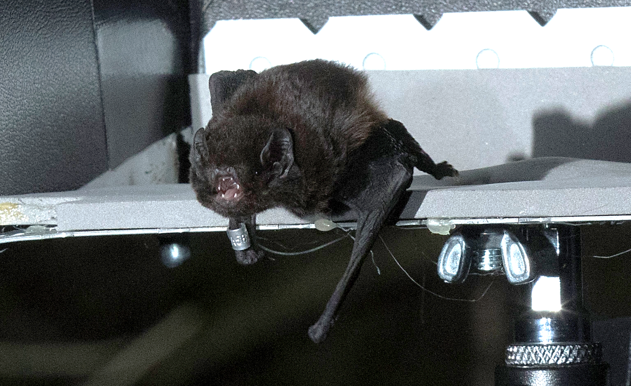
Pekapeka asks us to reconnect the working landscape with nature
Forest to stream
Farm to reserve
Reserve to city
One generation to the next
DOC courtesy of Andrew Styche
Notes:
Talk about saving the last kōkako from Pirongia . Kōkako recovery demonstrates that science-led, sustained management can reverse decline.
Pekapeka show why a species can remain present across a broad landscape while continuing to decline.
Both need persistent vigilance against predators.
Both need habitat protected not as isolated polygons but as functioning systems.
Both expose the danger of treating a consent condition or mitigation package as the endpoint.
The evidence from kōkako is unusually strong: reducing rats and possums to very low levels produced marked increases in chick output and adult density.

Slide 15
If we restore and reconnect landscapes in which kōkako can sing and pekapeka can move safely through the night, we will have built better places and connections with nature for ourselves as well.
  It can mean community groups becoming true partners in conservation restoration management
  It can mean landowners and innovators being celebrated and supported rather than sidelined
  It can mean agencies learning to share knowledge and learning to incorporate other knowledge realms
  It can mean mana whenua exercising kaitiakitanga
Notes:
Both ask for constant vigilance. But vigilance does not have to mean an endless war fought only by experts

Slide 16
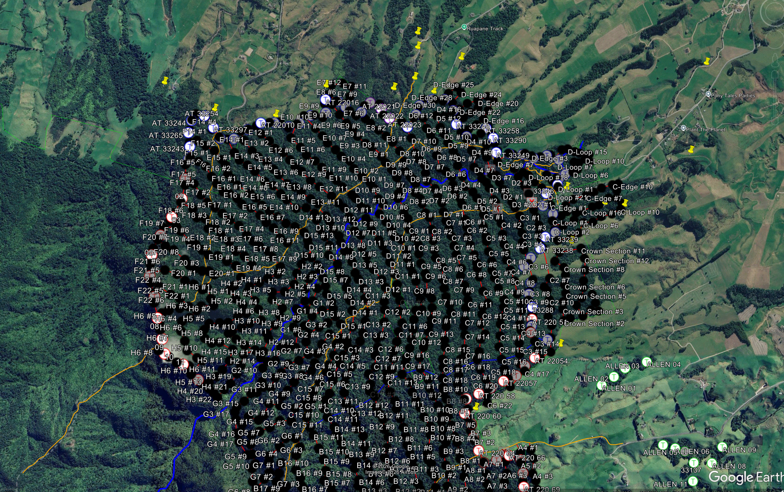
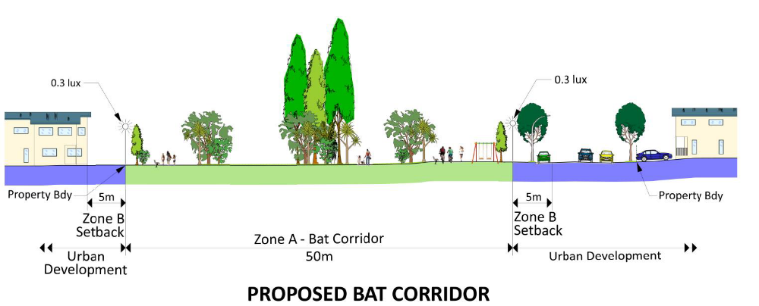
Restore habitat.
Restore connection.
Restore and reconnect ourselves.
Notes:
Figure 7 Examples of corridor bat habitat landscape features in urban development areas Presence is not persistence
A bird seen once, a bat pass recorded, a covenant registered or trees planted are signals, not outcomes. Persistence requires habitat quality, reproduction, predator control and monitoring.
Protection is a relationship, not an event
Consent conditions, translocations, covenants and project launches are beginnings. Your documents repeatedly show that success rests on trust, clear responsibilities, ongoing contact, resourcing and learning.
Connectivity applies to people too
Ecological fragmentation has an institutional counterpart: divided agencies, property boundaries, short funding cycles, siloed disciplines and consultation without shared authority. Restoring connections between organisations and communities is part of restoring the landscape.
Five concise takeaways
Protect mature habitat before attempting to recreate it.
Plan for ecological networks, not isolated sites.
Control predators at the scale and duration the species require.
Combine rules, incentives, relationships and monitoring.
Treat tangata whenua partnership and community capability as core conservation infrastructure.

Slide 17
