Slide 1
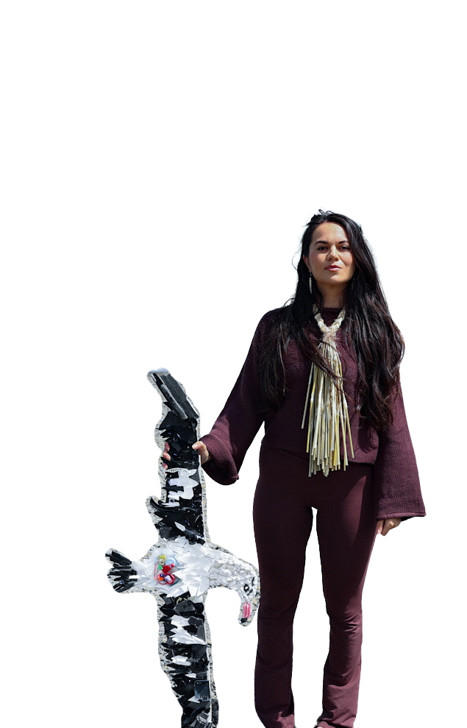
2026
Mā te mauri
e kōrero ana
ENDANGERED SPECIES FOUNDATION NATIONAL HUI
PRESENTED BY
MICHAELA RARUA INSLEY -Arahou innovations
Notes:
Introduction - ko wai au.

Slide 2
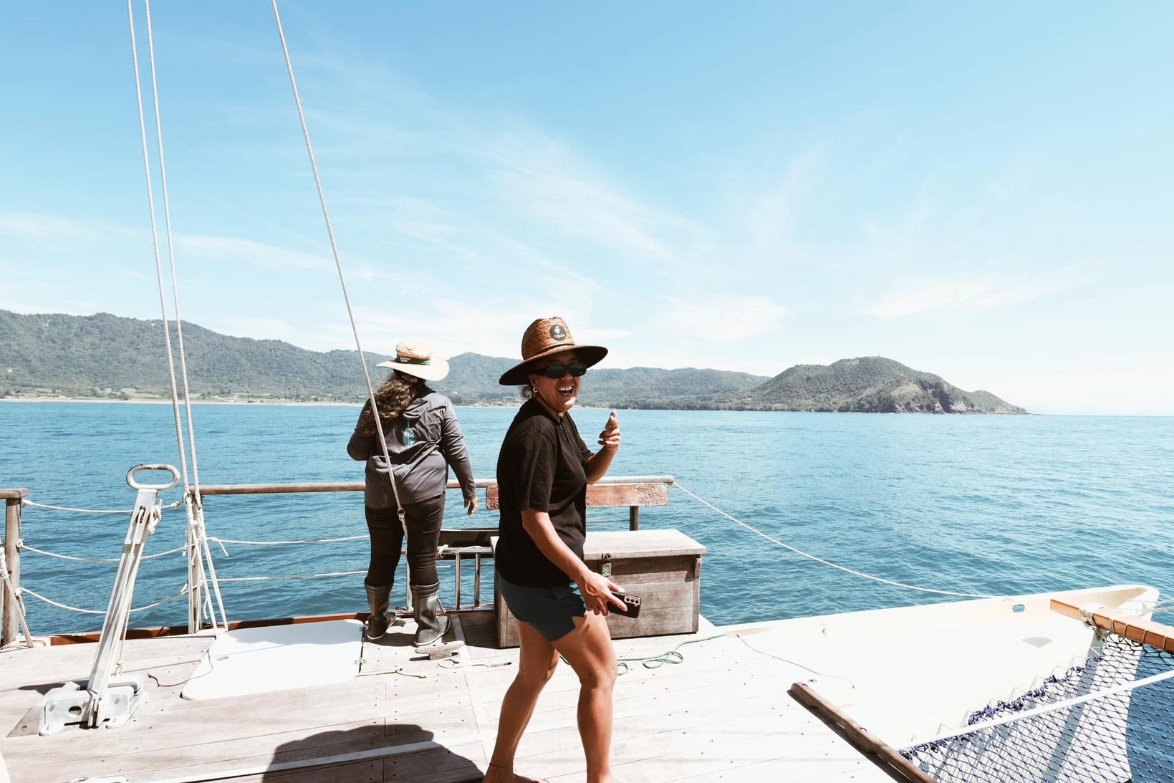
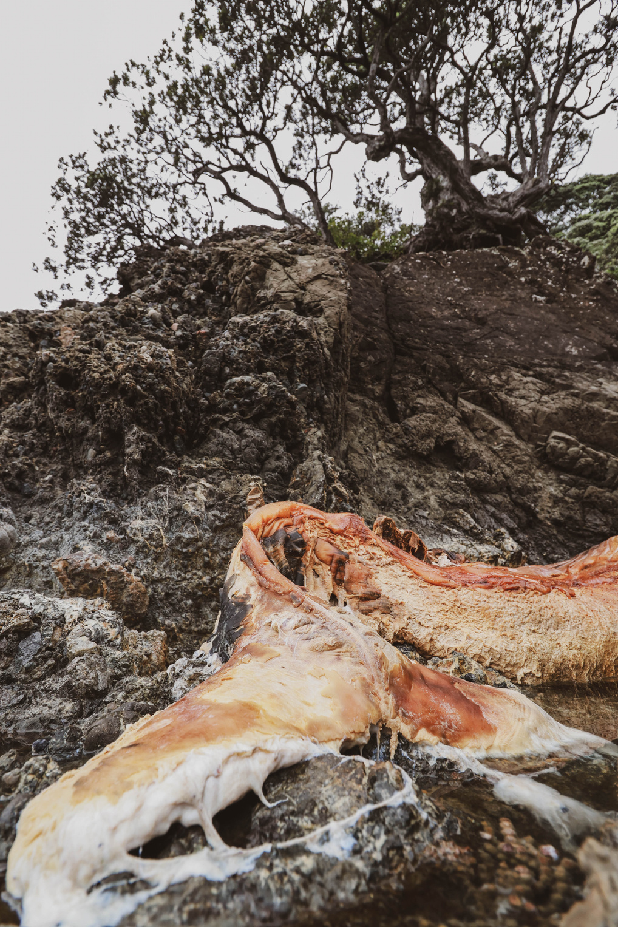
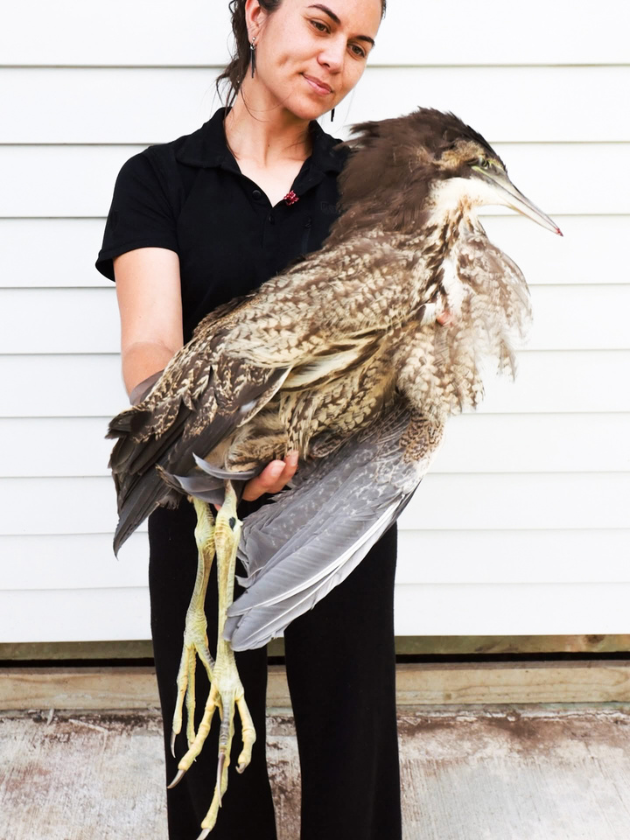
Connection through “isolation”
Our relationship with Mauri begins with our ability to connect with the ao taiao, the environment.
We do this through:
  Kōrero tuku iho - learning the stories and knowledge passed down through generations
  Mahinga kai - connecting with the places, resources and practices that sustain us
  Whakapapa - recognising the relationships and connections between people, whenua and taiao
  Our own experiences - the ways we each learn and engage with the environment.

Slide 3
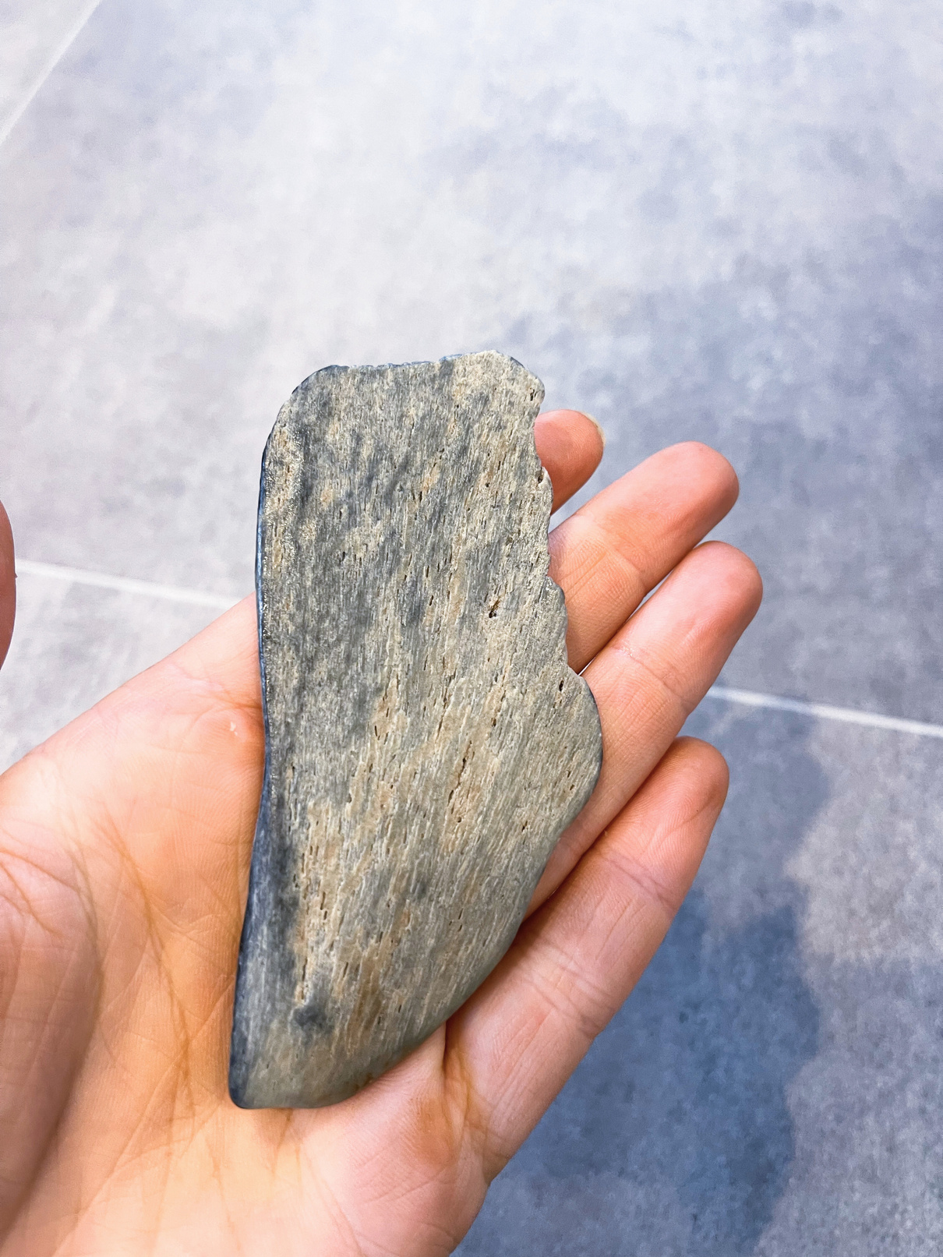
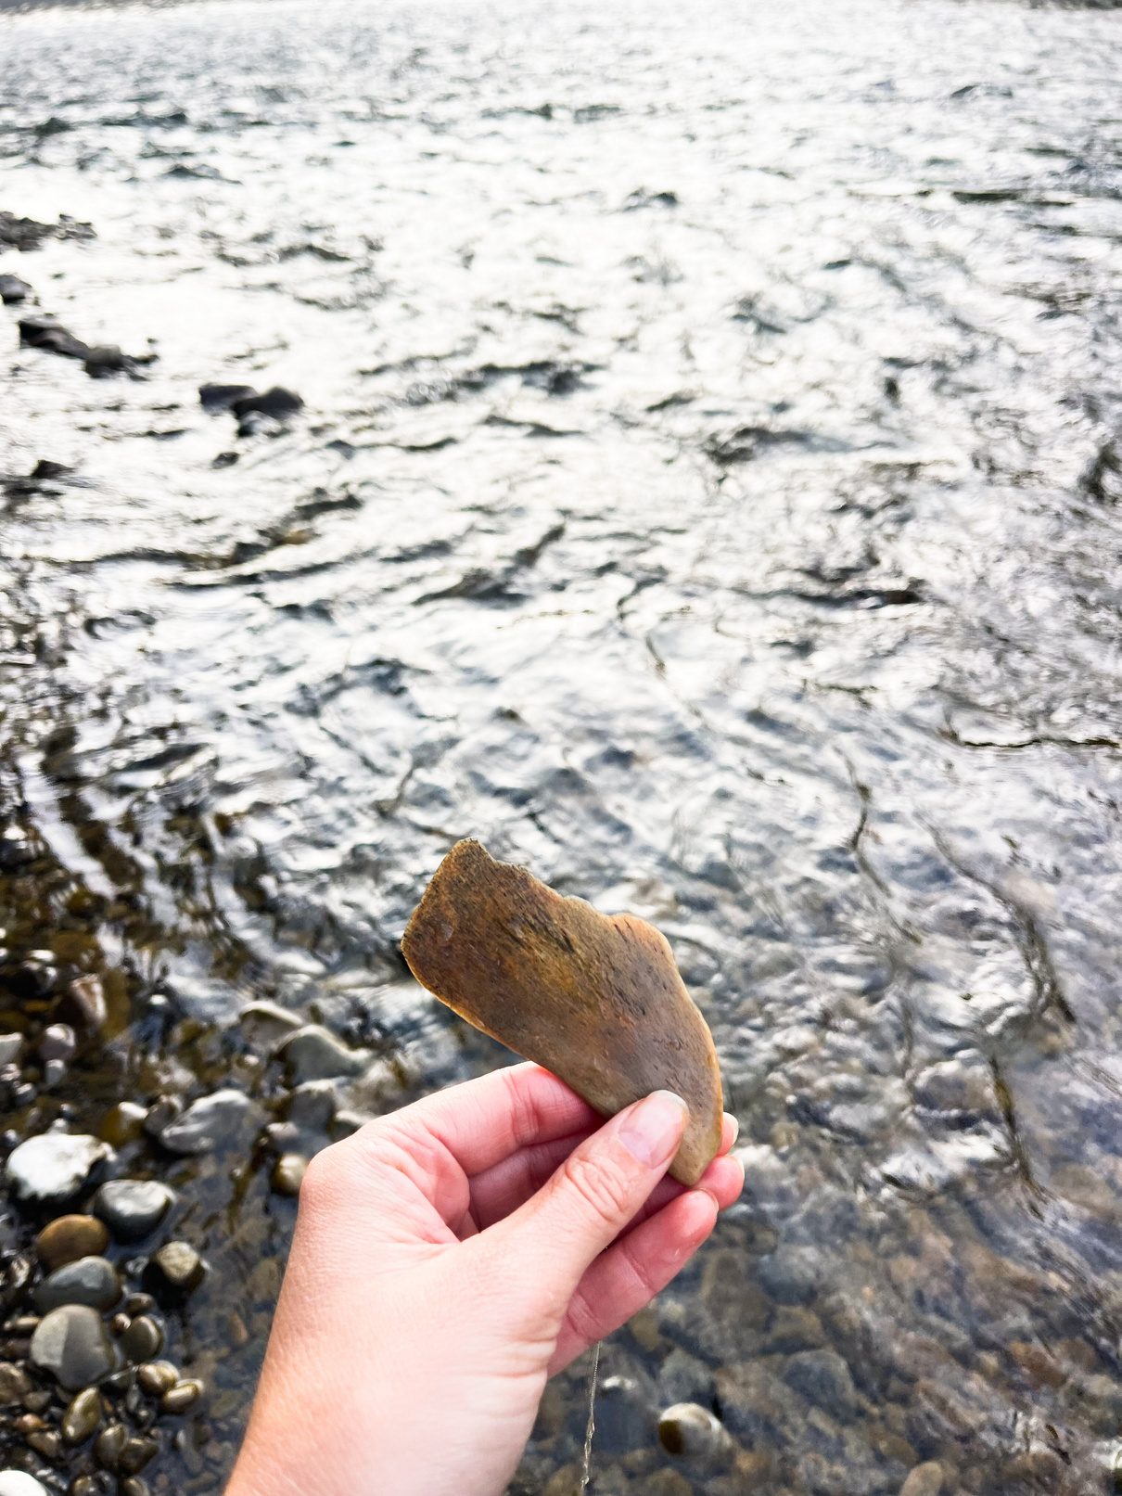
Experiences with Mauri
We need to consider how we have been taught to see the world.
  Are humans separate from nature or are we part of it?
  Can nature speak to and through me?
  Do we see taiao as a resource or as a relationship?
  Do we ask what the environment can benefit to us or what our responsibility is with it?
  Do we see ourselves as individuals or as part of a wider network of connection?

Slide 4
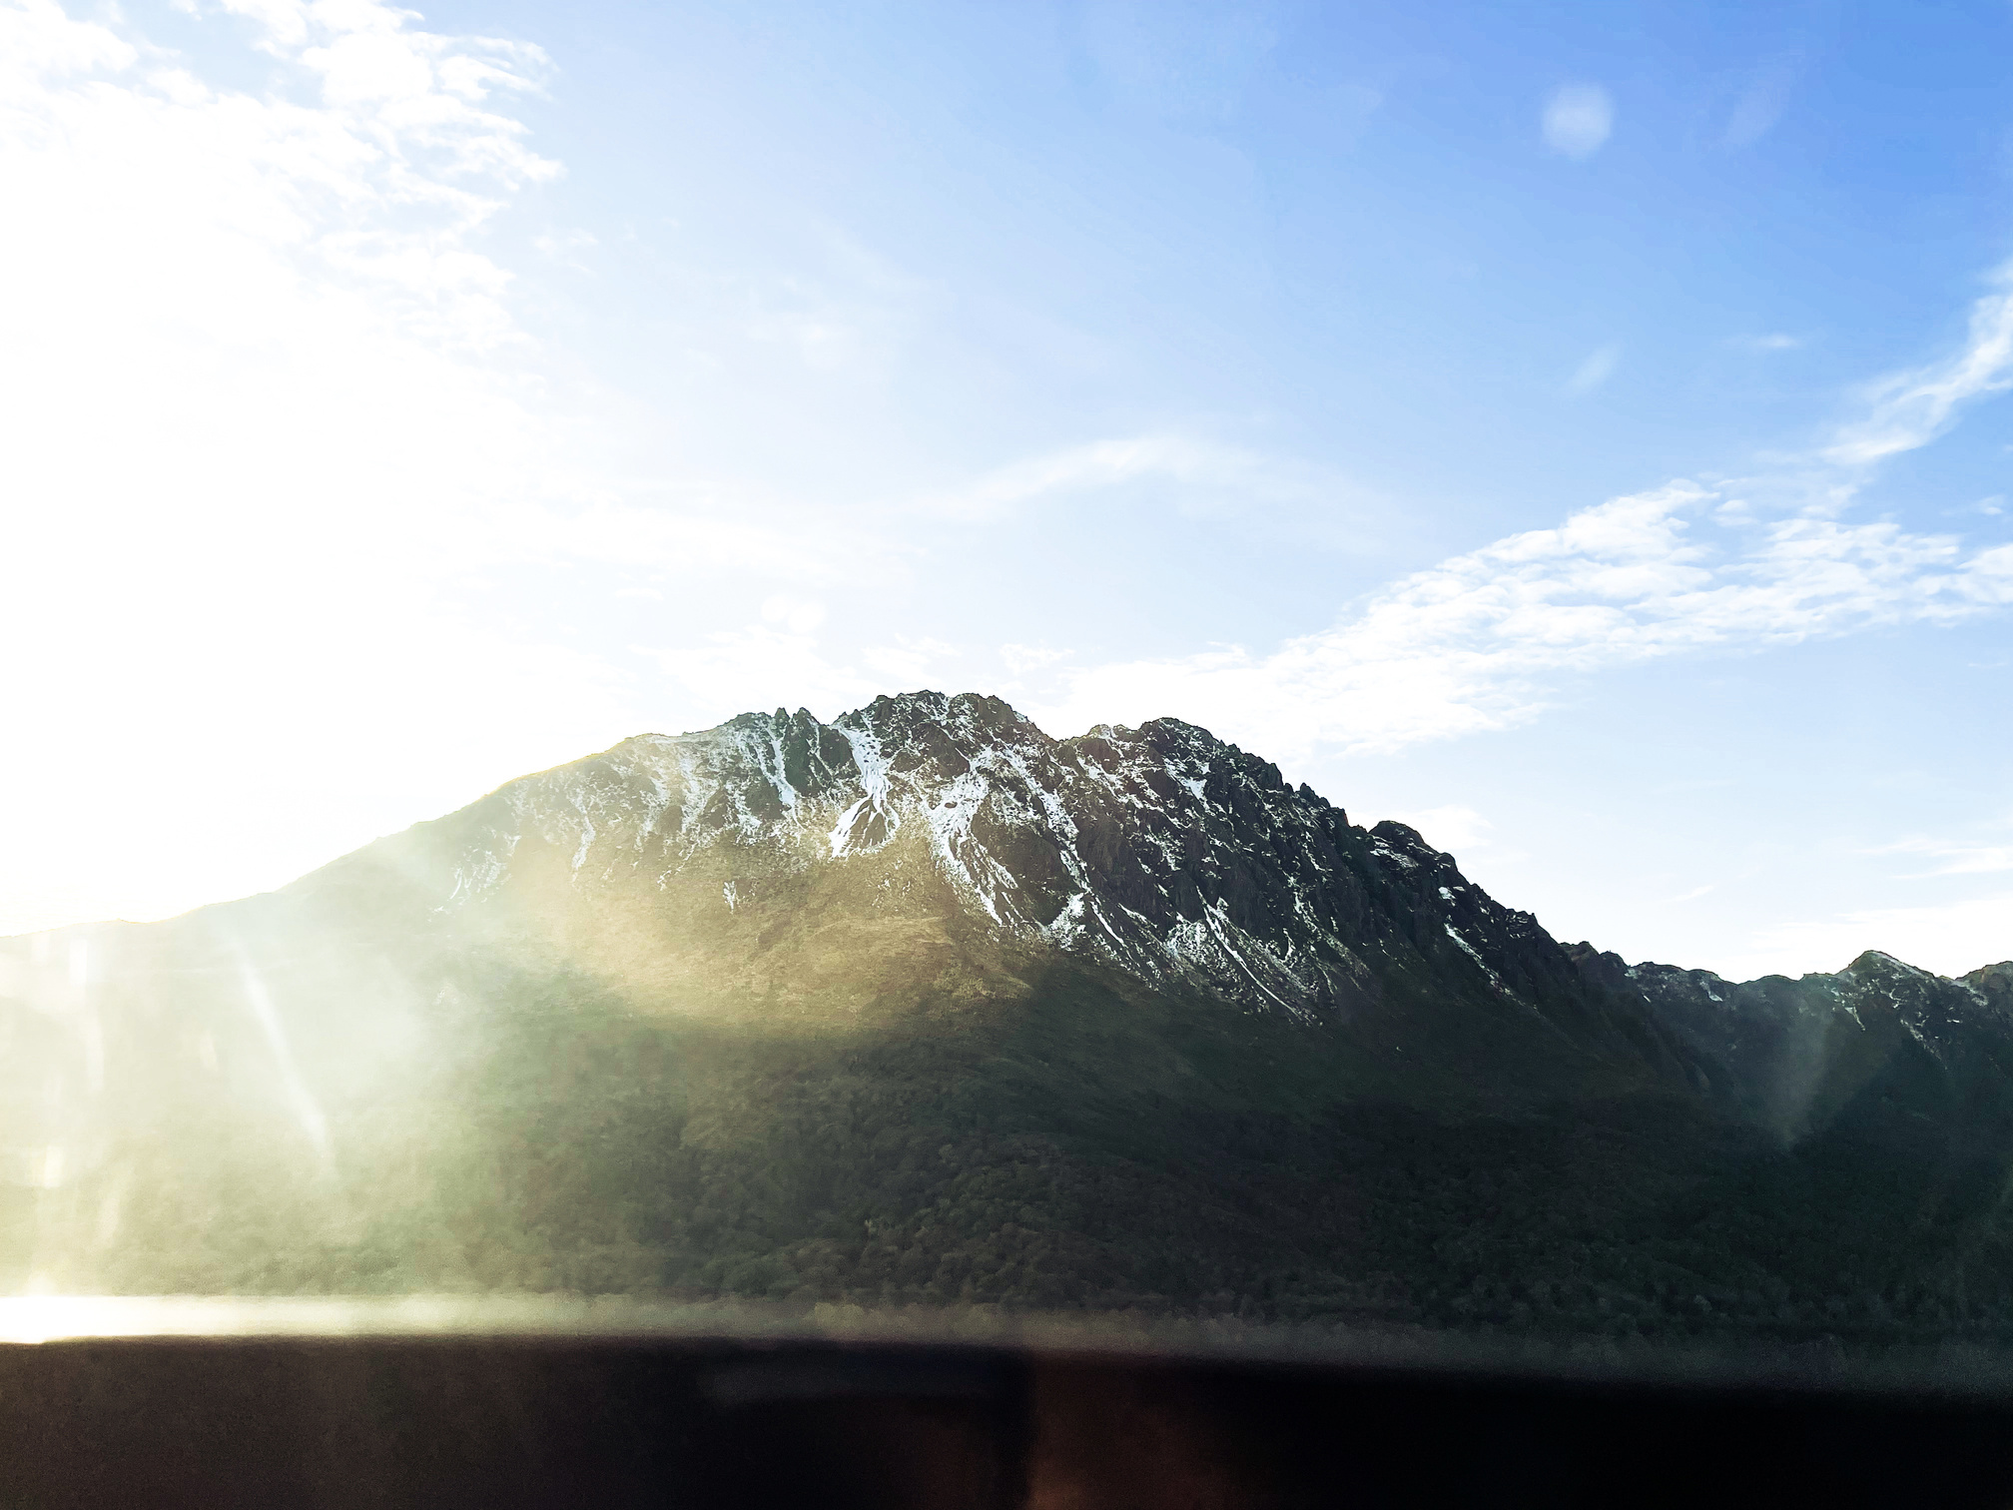
Mā te mauri e
kōrero ana
Letting mauri speak for itself
Life around us is always communicating. The question is whether we know how to notice it. We don’t measure mauri through numbers - we understand it through what we observe.
Through tohu, we see patterns and changes.
Through our senses, we hear, smell, and experience a place. Through observation, we recognise condition and behaviour. Through intuition, we make sense of what it all means.
On their own, these are just pieces. But together, they give us a clear understanding of the mauri across all types of living systems.
MIROMIRO
  East Coast, Ruatoria

Slide 5

MTMEKA
  What we physically experience: smell, taste, see, hear and feel.
What we consciously
  notice about our surroundings.
  Environmental signs which present themselves.
  What we know without needing to explain.
  TOHU
  SENSES
  OBSERVATION
  INTUITION
  THE PROCESS OF UNDERSTANDING MAURI
  INTERPRET
  THRIVING
  BALANCED
  PRESSURED
  COMPROMISED

Slide 6
The response
  INTENTION
  ACTION
  What are you bringing into the space? Your purpose, your mindset, reasoning.
What do you do with that understanding?
  Reduce, support, restore and adjust behaviours.
  ATTENTION
  OUTCOME
What are you noticing?
  What specifically stood out during measurement stage.
  The impact on people, place, and the wider system - the state of mauri.

Slide 7
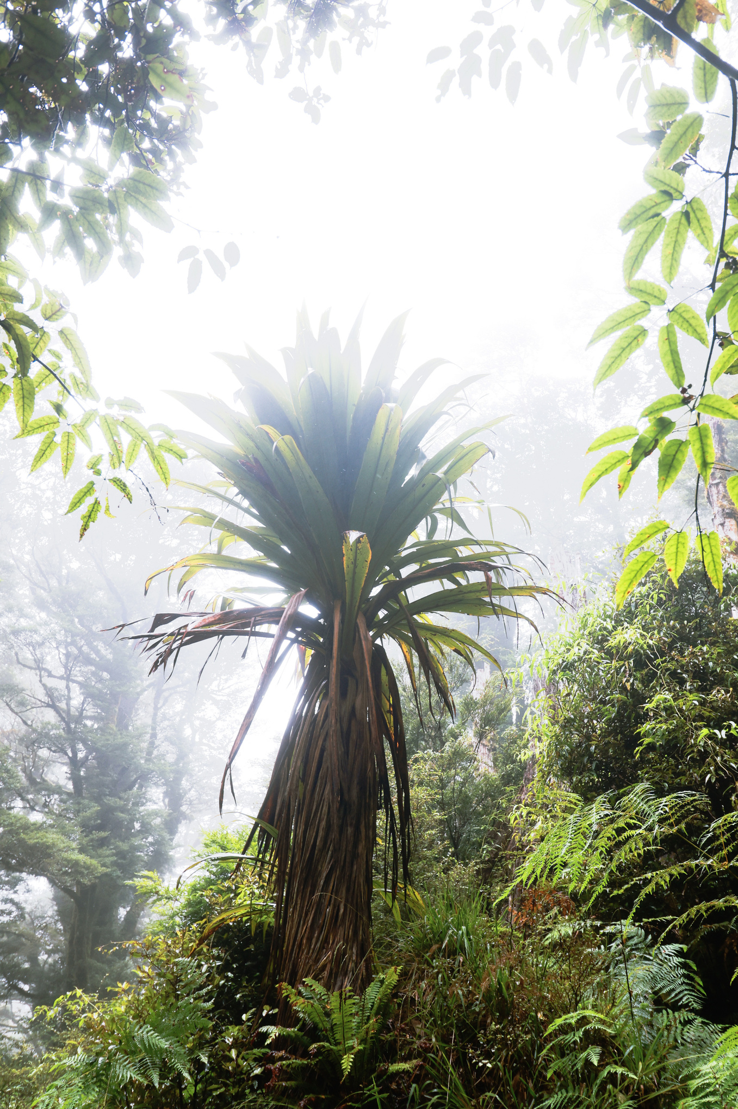
Engaging with
Mauri
  Instead of just talking about mauri, let’s work with it. Mauri isn’t a single measurement, its many strands woven together through relationship. Thats what we're going to action here today.
  Mountain Tī Kouka
  RAUKŪMARA NGAHERE

Slide 8
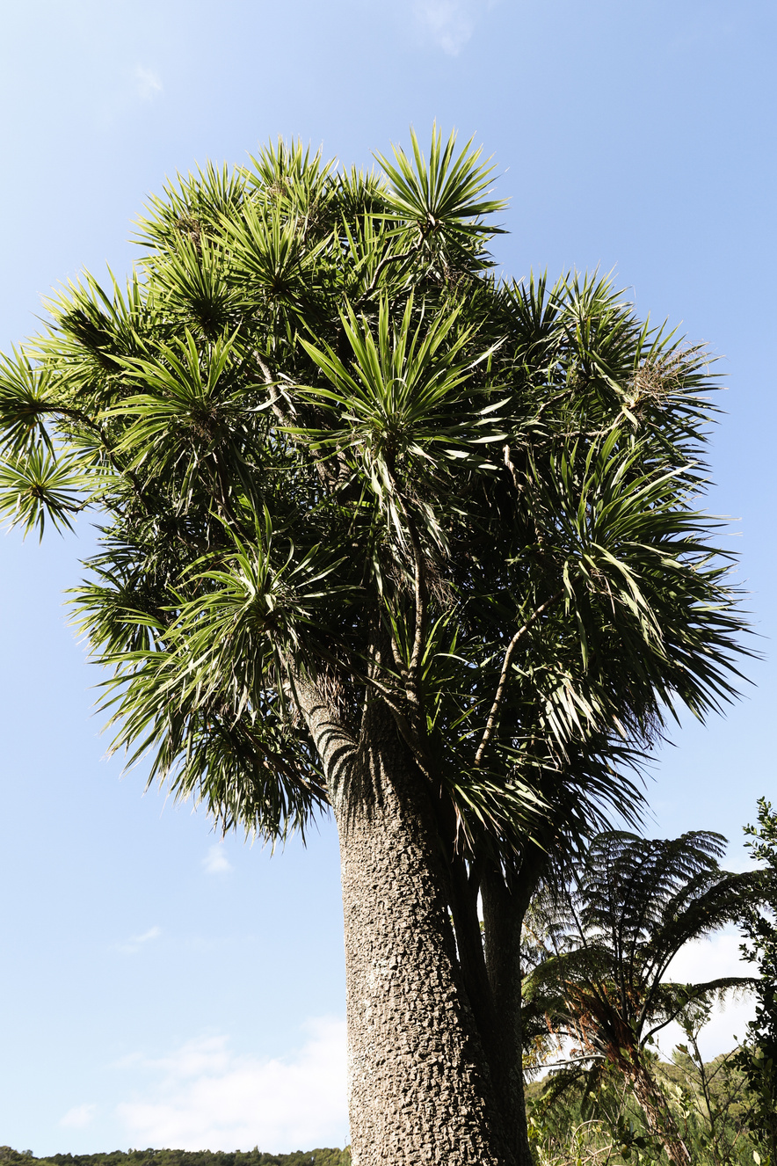
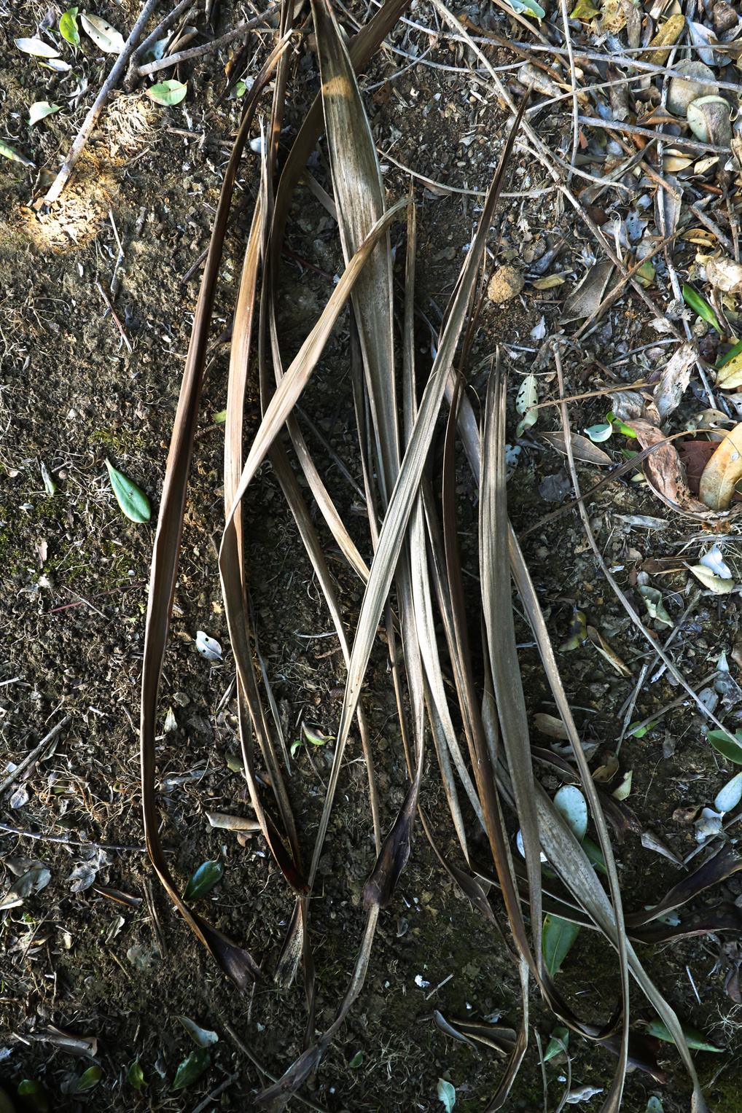
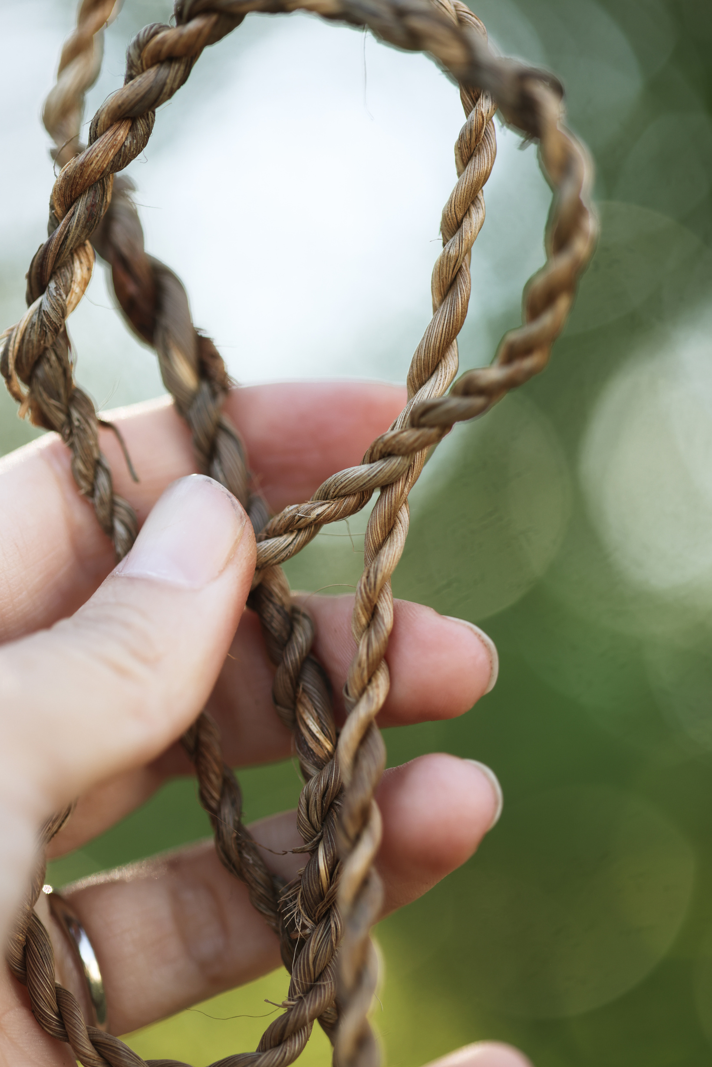
Tī kouka rope
TREE
LEAFLETS
ROPE

Slide 9
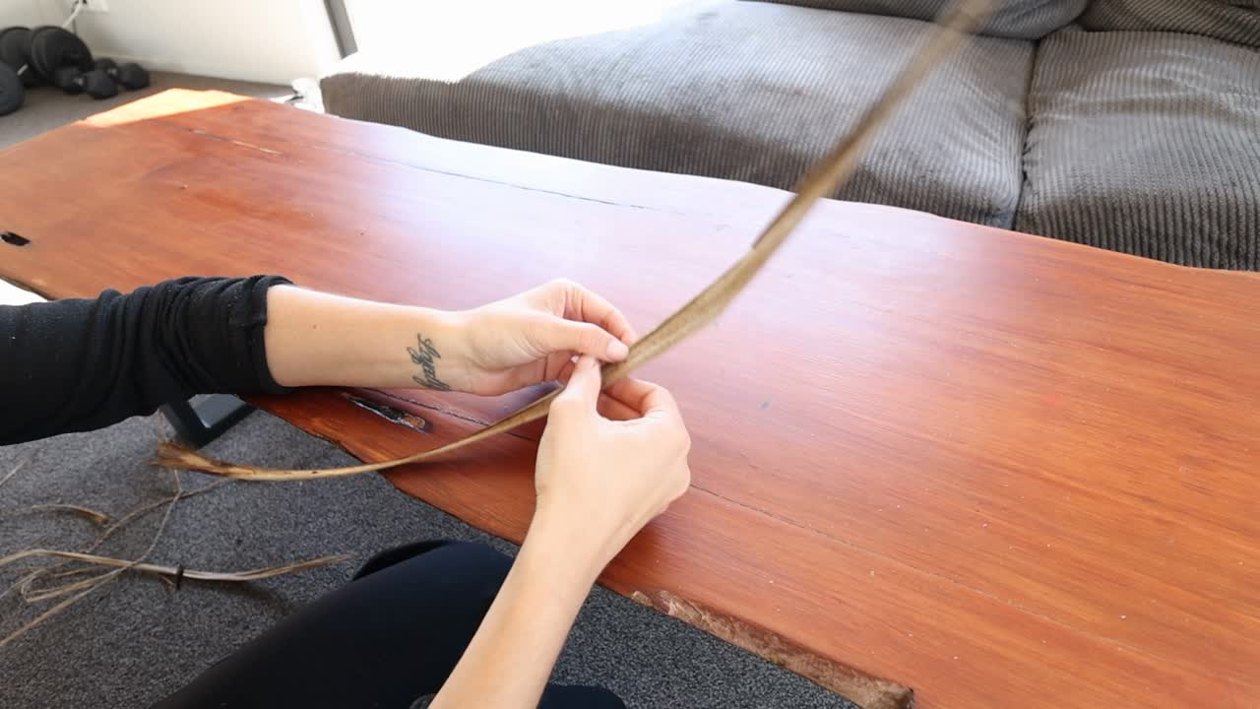
Video step
by step:
Weaving Tī Kouka rope

Slide 10
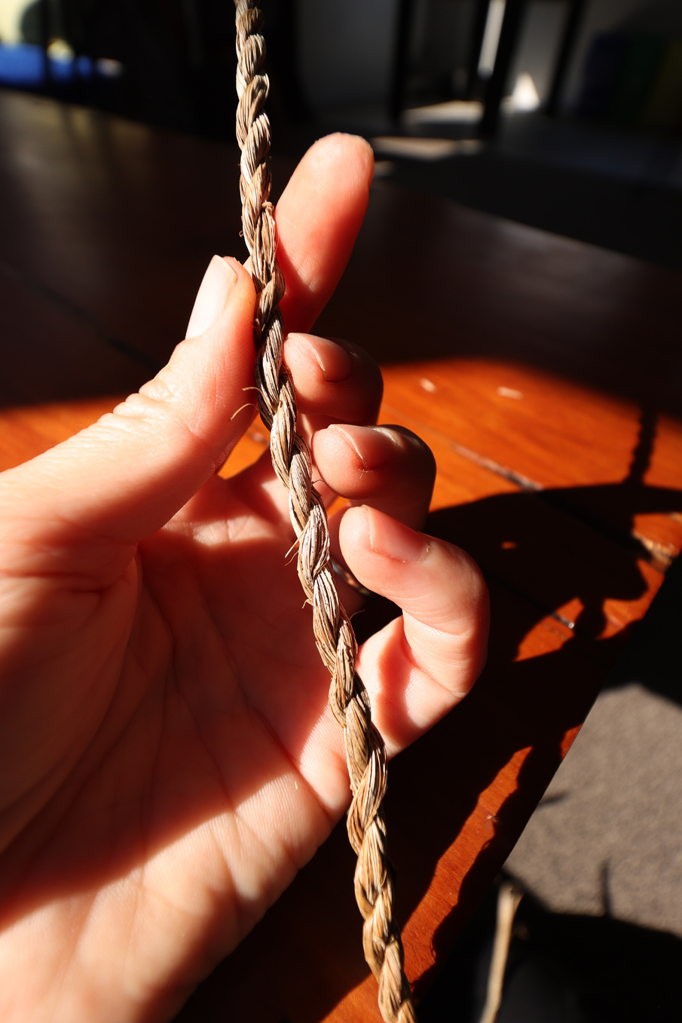
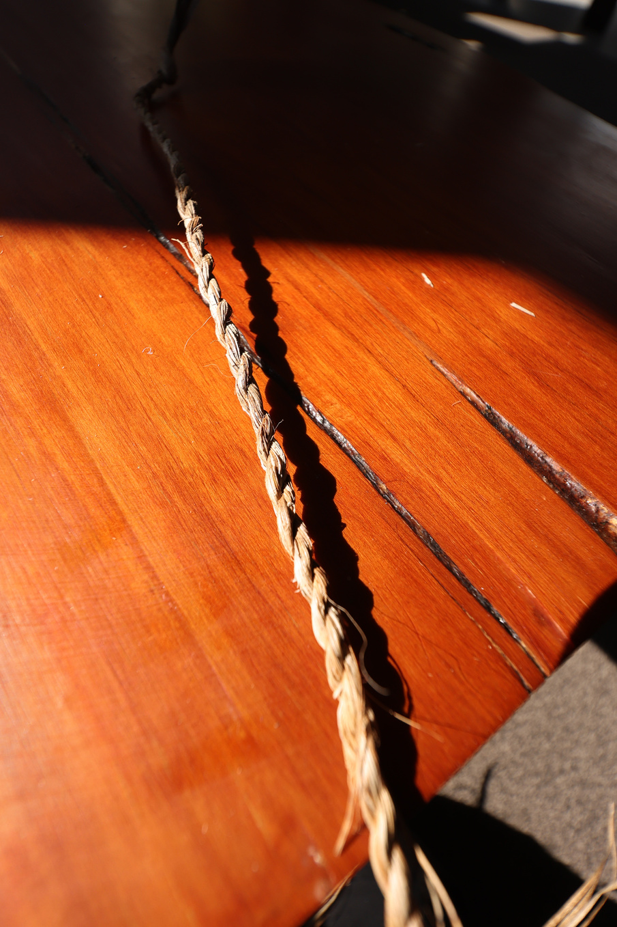
Weave instructions:
  Split your leaflet clean in half
  Tie both strands together with a knot at the soft end
  Begin twirling them until tight at the top
  Wrap right strand over the top of the left and hold tight
  Continue until complete and tie off
Tip: to make longer or thicker you add more
strands. Tī kouka rope is stronger than
Harakeke.

